Slide 1
Conduit

Slide 2
Team Members
Arjun Suvarna
Iyaaz Hassan Mohtisham
Keerthan P. M.
Bhavana B. Shetty
Ashik K.

Slide 3
Introduction
In this project we made an online platform in which users can share articles and posts among other users.
Anyone can go to conduit home page and view all the posts made by the registered users.
In order for the users to post their own articles , comment and like any posts they will have to register their account.
Once the users make an account they can add bio and profile picture to their account.

Slide 4
Problem Statement
Community specific discussion portal to share thoughts and articles.
Secure Online portal for publishing articles.
Features such as “likes” and “comments” to enable community discussion.

Slide 5
Technology Stack Used
BackEnd
MySQL
And
MongoDB
Front End
HTML
CSS3
Jquery
JavaScript
TypeScript
Bootstrap 4
Angular 8
MiddleWare
Java 8.x
Spring 5.1.9
NodeJS
Spring Boot 2.1.8
Eureka Discovery Client
JPA
Lombok

Slide 6
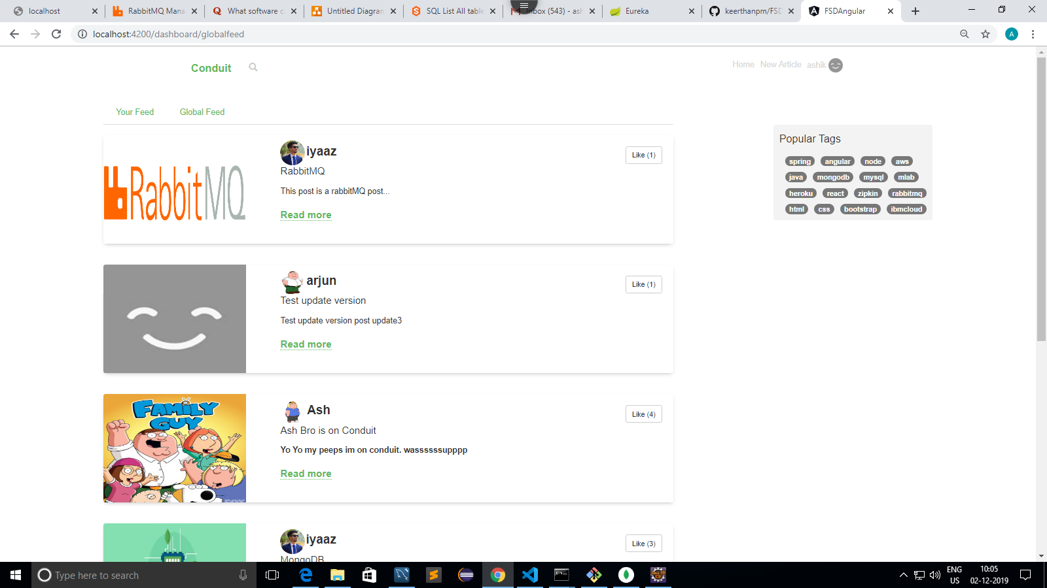
Demo
Let’s get into the Project to have a better understanding!

Slide 7
Angular Architecture

Slide 8
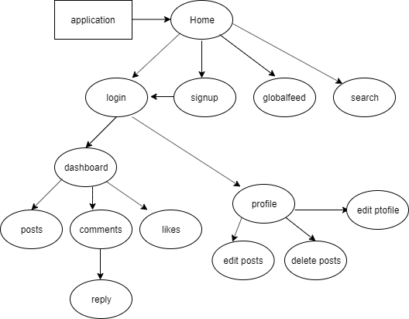
.

Slide 9
Database Architecture

Slide 10
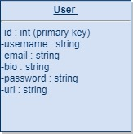
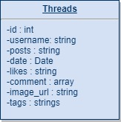
User table in MySql
Threads table in MongoDB

Slide 11
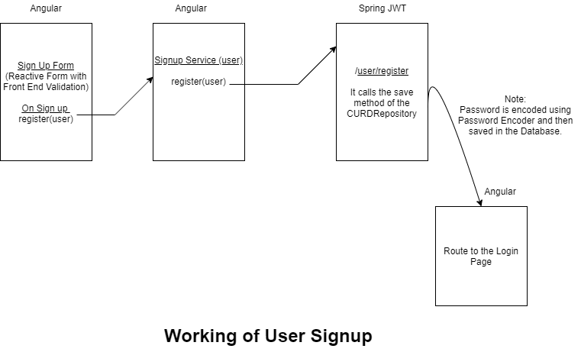

Slide 12
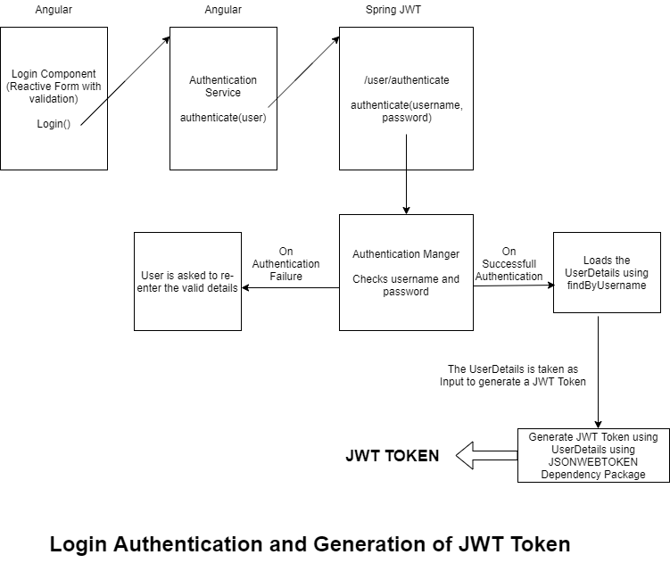

Slide 13
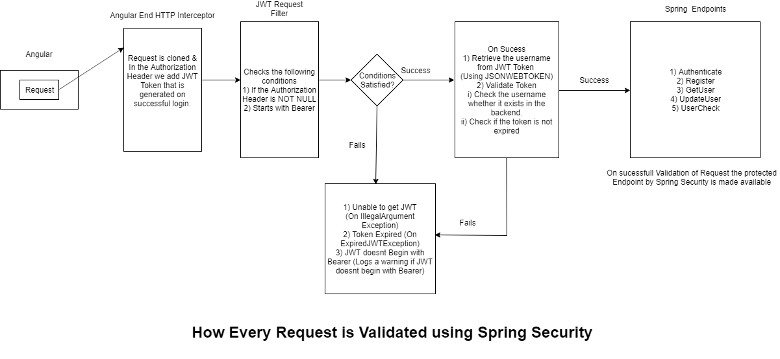

Slide 14
Microservice Architecture

Slide 15
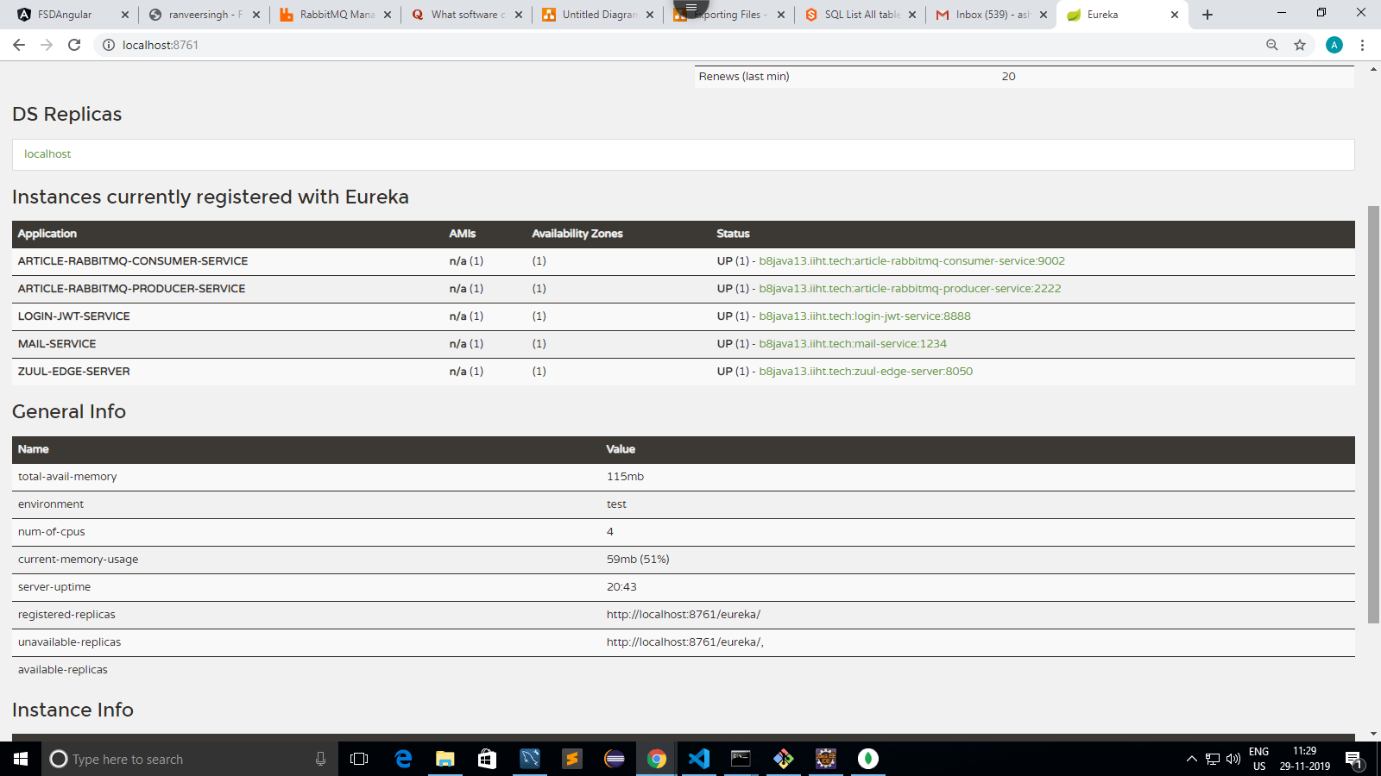
5 spring microservices are running.

Slide 16
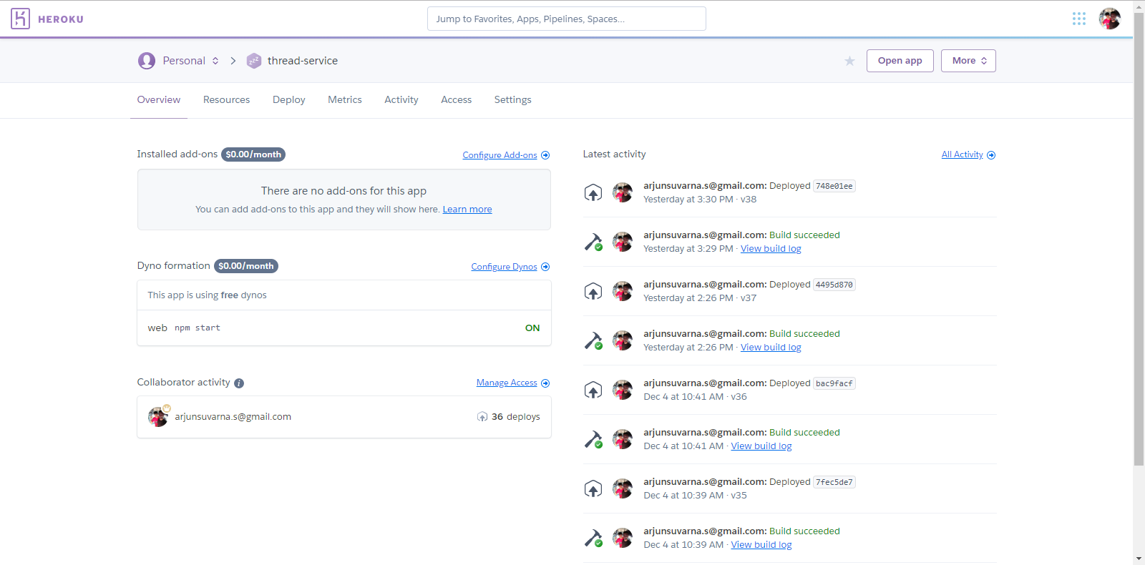
Node services are deployed in heroko

Slide 17
Deployment
Angular:
https://g2keqy6x0h.execute-api.eu-central-1.amazonaws.com/production
Pivotal (cloud foundary)
DataBase:
//bootdb.ced3sifakus9.us-east-2.rds.amazonaws.com:3306/bootdb? (Amazon AWS)
Spring:
ec2-3-14-66-15.us-east-2.compute.amazonaws.com (Amazon AWS)
NodeJS:
thread-interceptor-service: https://thread-interceptor.herokuapp.com/
thread service: https://thread-service.herokuapp.com/
://thread-interceptor.herokuapp.com/

Slide 18
Testing
Angular
Jasmine
Karma
Java
JUnit

Slide 19
Future Scope

Slide 20
Thank you!

